Slide 1











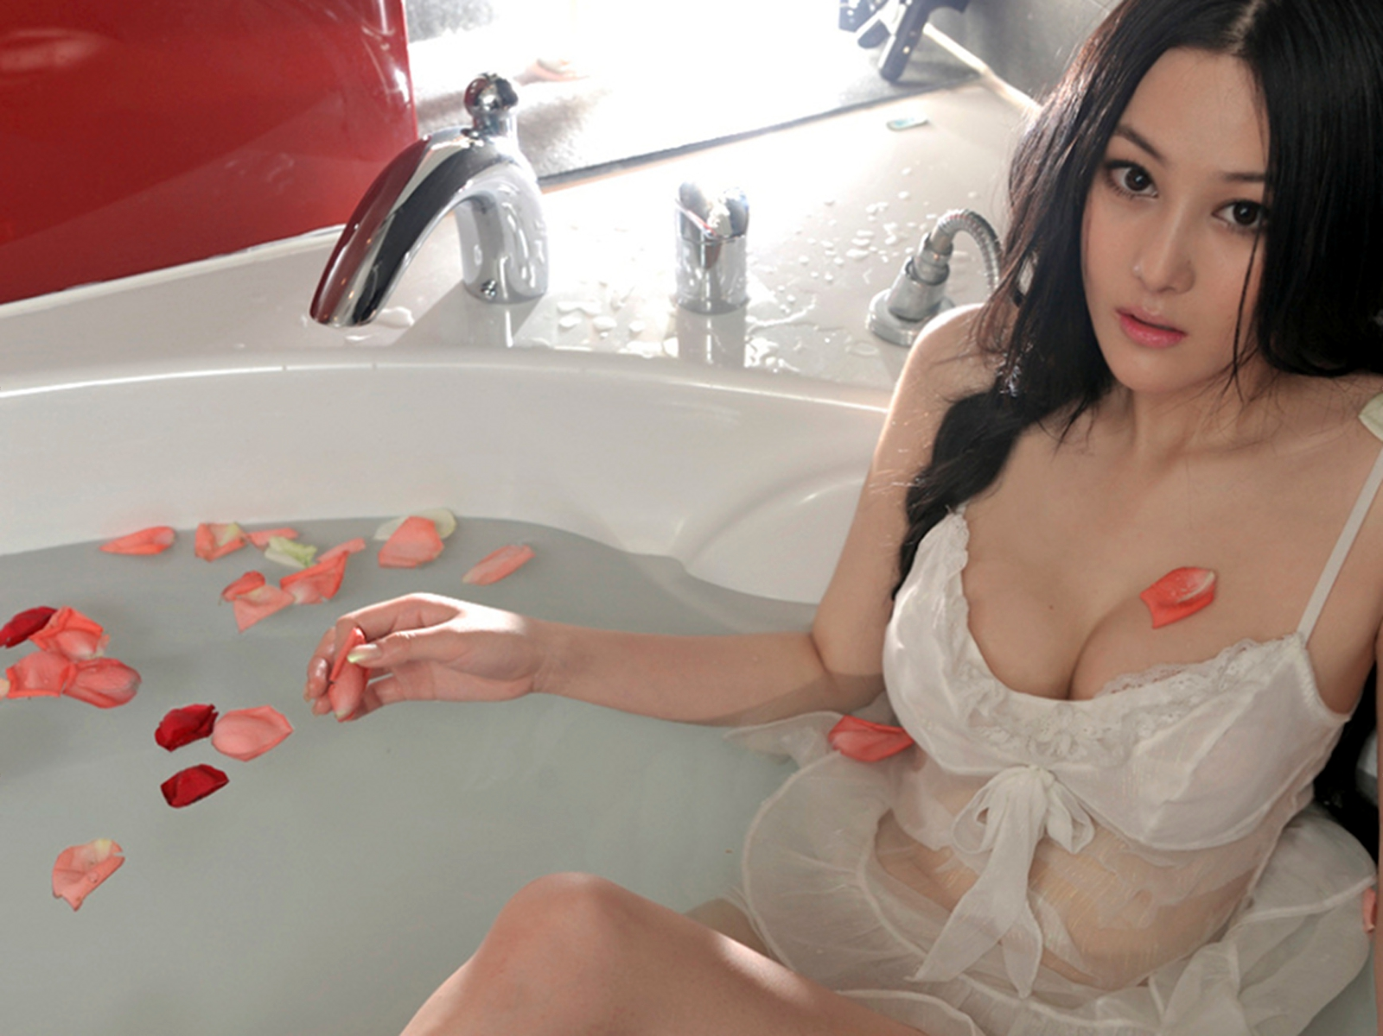




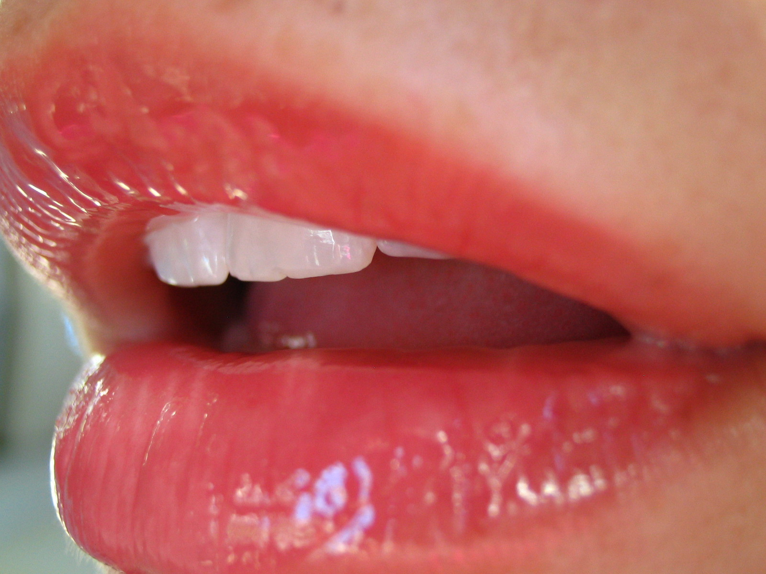
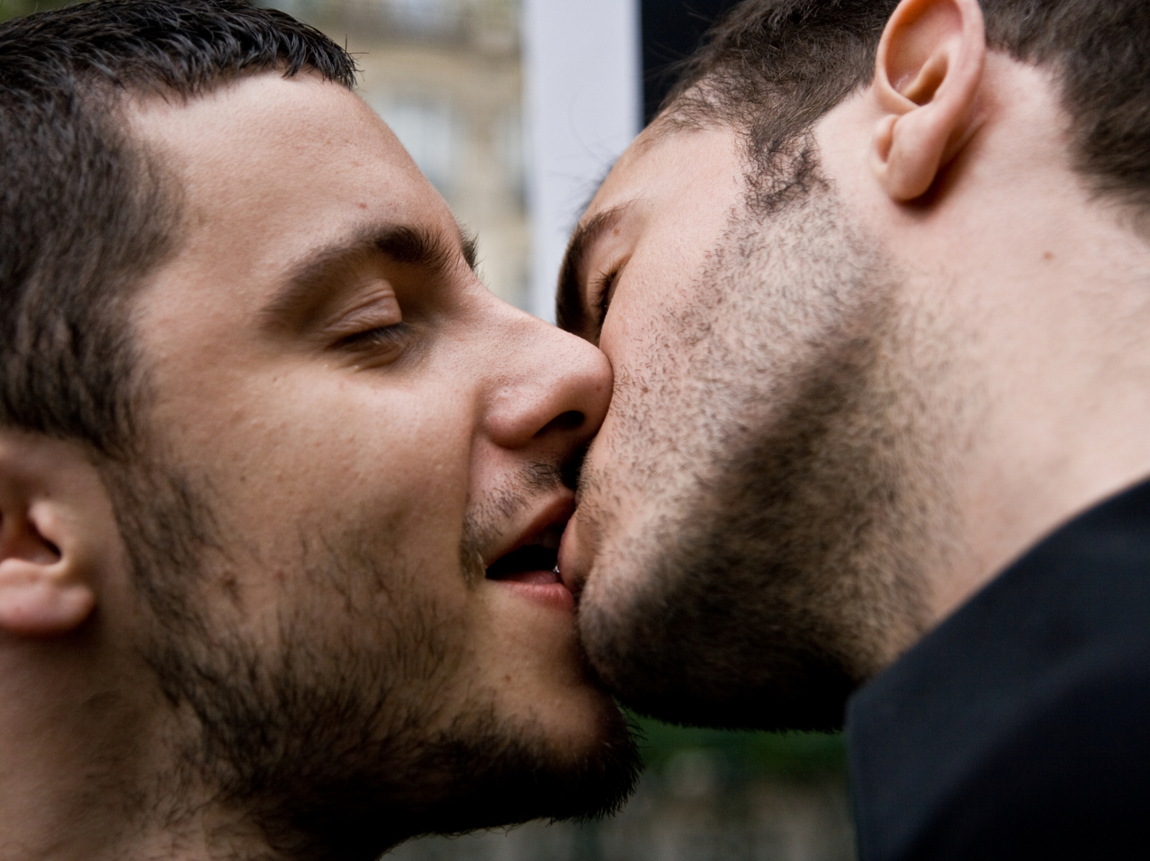
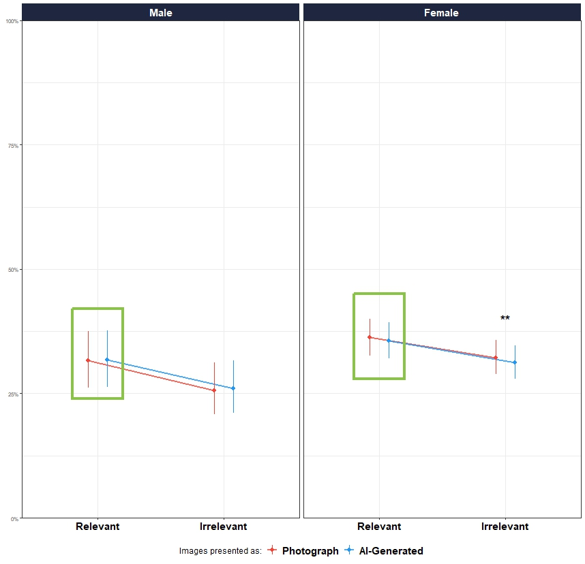
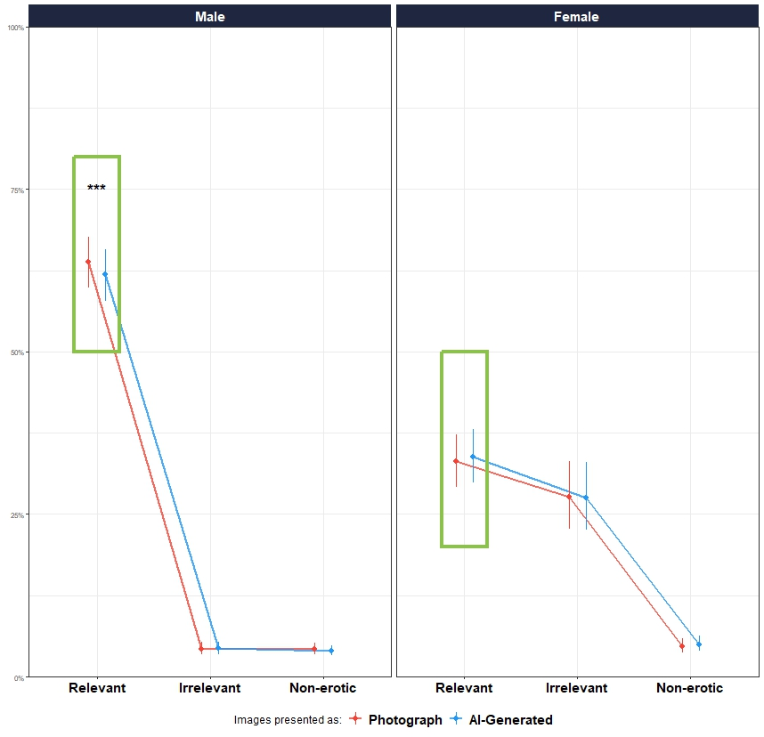
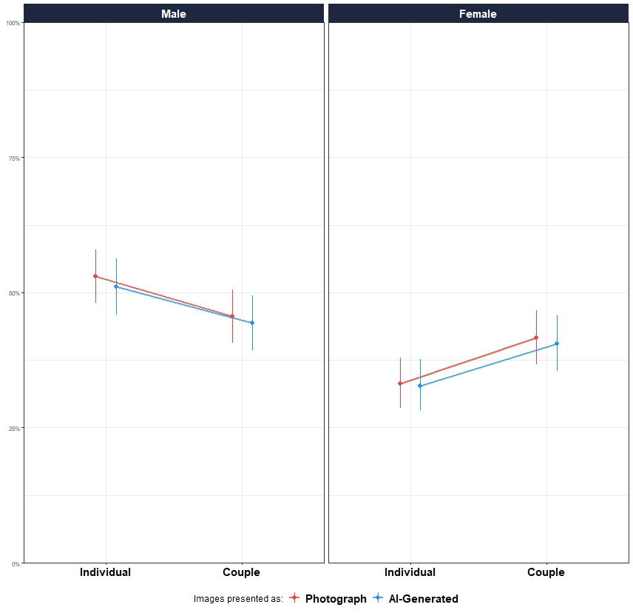


Do We Find AI-Generated Less Emotional? The Impact Of Reality Beliefs On Affective Responses
Ana Neves, ….
SCAN ME FOR MORE DETAILS!!
Advances in AI and immersive tech (e.g., VR) are blurring the line between real and fake, making it harder for people to distinguish real from fictional - often with serious consequences, such as misinformation¹.
For instance, deepfake technologies can generate realistic fake videos of politicians, spreading false narratives²
Emotions shape how we interpret and respond to our environment³ and play a key role in how we process ambiguous or fictional content. Studies show that framing stimuli as fictional reduces emotional impact:
↓ Valence & intensity for neutral/negative videos⁴
↓ Intensity for negative pictures⁵ ↓ Physiological arousal, subjective arousal, intensity & valence for negative and neutral images⁶
INTRODUCTION
STUDY 1
DATABASE: American Multiracial Face Database⁷
PHASE 1
AI-GENERATED
STIMULI #1
SUBJECTIVE SCALES
PHOTOGRAPH
STIMULI #2
SUBJECTIVE SCALES
PHOTOGRAPH
STIMULI #3
VARIABLE: Attractiveness
STUDY 2
DATABASES: Nencki Affective Picture System⁸ AND NAPS Erotic subset (NAPS ERO⁹)
STIMULUS
STIMULI #3
REALNESS SCALE
STIMULI #5
REALNESS SCALE
STIMULI #1
REALNESS SCALE
STIMULI #8
REALNESS SCALE
VARIABLE: Arousal
PHASE 2
STUDY 3
DATABASE: NAPS Erotic subset (NAPS ERO⁹)
VARIABLE: Arousal
“AI-Generated” beliefs leads to a decrease in emotional responses
STUDY 1 - FACES
STUDY 2 - EROTIC + NON-EROTIC
STUDY 3 - EROTIC
Figure 1. Estimated marginal means of attractiveness ratings across image relevance (relevant vs. irrelevant) and condition (photograph vs. AI-generated). Error bars represent 95% confidence intervals. Estimates are based on a generalized linear mixed model with participant- and stimulus-level random effects. ** p < . 01.
Figure 2. Estimated marginal means of arousal ratings across image relevance (relevant vs. irrelevant vs non-erotic) and condition (photograph vs. AI-generated). Error bars represent 95% confidence intervals. Estimates are based on a generalized linear mixed model with participant- and stimulus-level random effects. *** p < . 001.
Figure 3. Estimated marginal means of arousal ratings across stimuli type (i.e., image of an individual or a couple) and condition (photograph vs. AI-generated). Error bars represent 95% confidence intervals. Estimates are based on a generalized linear mixed model with participant- and stimulus-level random effects. * p < . 05. All pictures were relevant.
N: 206 participants (Mean age = 27.8, SD = 13.6, range: (18, 69); Gender: 76.7% women, 23.3% men)
Effect of condition: Significant only for women, and only for irrelevant images (e.g., heterosexual women rating female faces); β = –0.05, 95% CI [–0.08, –0.001], p = .006.
Moderation by Honesty-Humility¹⁰: Among women, higher Honesty-Humility predicted lower attractiveness ratings for AI-labelled irrelevant images vs photos (β = –0.03, p = .008).
N: 705 participants (M age = 30.2, SD = 11.8, range = 18–80); 35.7% women, 64.3% men.
Effect of condition: Significant only for men, and only for relevant images (e.g., heterosexual men rating erotic images of women); β = –0.07, 95% CI [–0.13, –0.006], p = .031.
Moderation by AI-arousal feedback: Men who believed AI images were less arousing rated them lower in arousal than photo-labelled images (β = –0.16, p = .009).
N: 197 participants (M age = 36.5, SD = 13.1, range = 18–80); 48.2% women, 51.8% men.
Effect of condition: Significant only for men, and only for erotic images of individuals; β = –0.08, 95% CI [–0.15, –0.01], p = .019.
Moderation by AI-attractiveness feedback : Among men, those who believed AI images were more attractive also rated them as more arousing (β = 0.14, p = .034).
Perceived artificiality reduces emotional responses, but only in specific gender and relevance contexts - women for irrelevant images (e.g., same-gender faces), and men for relevant erotic images.
Beliefs about AI played a key role: men who believed AI images were less arousing rated them lower, while others rated them higher when they believed AI images were more attractive - Among women, the effect was stronger for those high in Honesty-Humility, suggesting that individual moral traits influence reactions to artificial or fictional stimuli.
These findings support Affective Reality Theory (Makowski, 2023), showing that emotions and beliefs shape how real or impactful something feels, even when participants know it is artificial.
In a broader context, this has implications for AI-generated media and misinformation, where emotional and behavioural reactions may depend more on beliefs than on objective realism.
¹ Miller, E. J., Foo, Y. Z., Mewton, P., & Dawel, A. (2023). How do people respond to computer-generated versus human faces? A systematic review and meta-analyses. Computers in Human Behavior Reports.
² Meskys, E., Kalpokiene, J., Jurcys, P., & Liaudanskas, A. (2020). Regulating deep fakes: legal and ethical considerations. Journal of Intellectual Property Law & Practice, 15(1), 24-31.
³ Mocaiber, I., Pereira, M. G., Erthal, F. S., Machado-Pinheiro, W., David, I. A., Cagy, M., ... & de Oliveira, L. (2010). Fact or fiction? An event- related potential study of implicit emotion regulation. Neuroscience Letters, 476(2), 84-88.
⁴ Sperduti, M., Arcangeli, M., Makowski, D., Wantzen, P., Zalla, T., Lemaire, S., ... & Piolino, P. (2016). The paradox of fiction: Emotional response toward fiction and the modulatory role of self-relevance. Acta psychologica, 165, 53-59.
⁵ Sperduti, M., Makowski, D., Arcangeli, M., Wantzen, P., Zalla, T., Lemaire, S., ... & Piolino, P. (2017). The distinctive role of executive functions in implicit emotion regulation. Acta psychologica, 173, 13-20. ⁶ Makowski, D., Sperduti, M., Pelletier, J., Blondé, P., La Corte, V., Arcangeli, M., ... & Piolino, P. (2019). Phenomenal, bodily and brain correlates of fictional reappraisal as an implicit emotion regulation strategy. Cognitive, Affective, & Behavioral Neuroscience, 19, 877-897.
⁷ Chen, J. M., Norman, J. B., & Nam, Y. (2021). Broadening the stimulus set: Introducing the American multiracial faces database. Behavior Research Methods, 53, 371-389.
⁸ Wierzba, M., Riegel, M., Pucz, A., Leśniewska, Z., Dragan, W. Ł., Gola, M., ... & Marchewka, A. (2015). Erotic subset for the Nencki Affective Picture System (NAPS ERO): cross-sexual comparison study. Frontiers in psychology, 6, 1336. ⁹ Marchewka, A., Żurawski, Ł., Jednoróg, K., & Grabowska, A. (2014). The Nencki Affective Picture System (NAPS): Introduction to a novel, standardized, wide-range, high-quality, realistic picture database. Behavior research methods, 46, 596-610.
¹⁰ Olaru, G., & Jankowsky, K. (2022). The HEX-ACO-18: Developing an age-invariant HEXACO short scale using ant colony optimization. Journal of Personality Assessment, 104(4), 435-446.
DISCUSSION

Slide 2
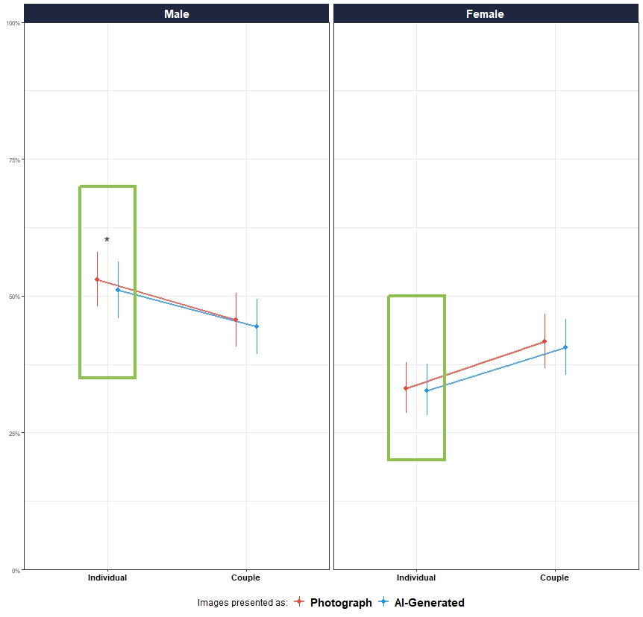
Do We Find AI-Generated Less Emotional? The Impact Of Reality Beliefs On Affective Responses
Ana Neves, ….
SCAN ME FOR MORE DETAILS!!
INTRO
Advances in AI and immersive tech (e.g., VR) are blurring the line between real and fake, making it harder for people to distinguish real from fictional - often with serious consequences, such as misinformation¹.
For instance, deepfake technologies can generate realistic fake videos of politicians, spreading false narratives²
Emotions shape how we interpret and respond to our environment³ and play a key role in how we process ambiguous or fictional content. Studies show that framing stimuli as fictional reduces emotional impact:
↓ Valence & intensity for neutral/negative videos⁴
↓ Intensity for negative pictures⁵ ↓ Physiological arousal, subjective arousal, intensity & valence for negative and neutral images⁶
STUDY 1
DATABASE: American Multiracial Face Database⁷
P H A S E 1
AI-GENERATED
STIMULI #1
SUBJECTIVE SCALES
PHOTOGRAPH
STIMULI #2
SUBJECTIVE SCALES
PHOTOGRAPH
STIMULI #3
STIMULI
VARIABLE: Attractiveness
STUDY 2
DATABASES: Nencki Affective Picture System⁸ AND NAPS Erotic subset (NAPS ERO⁹)
P H A S E
2
STIMULI #3
REALNESS SCALE
STIMULI #5
REALNESS SCALE
STIMULI #1
REALNESS SCALE
STIMULI #8
REALNESS SCALE
VARIABLE: Arousal
STUDY 3
DATABASE: NAPS Erotic subset (NAPS ERO⁹)
“AI-Generated” beliefs leads to a decrease in emotional responses”
VARIABLE: Arousal
RESULTS
STUDY 1 - FACES
STUDY 2
STUDY 3
Figure 1. Estimated marginal means of attractiveness ratings across image relevance (relevant vs. irrelevant) and condition (photograph vs. AI-generated). Error bars represent 95% confidence intervals. Estimates are based on a generalized linear mixed model with participant- and stimulus-level random effects. ** p < . 01.
Figure 2. Estimated marginal means of arousal ratings across image relevance (relevant vs. irrelevant vs non-erotic) and condition (photograph vs. AI-generated). Error bars represent 95% confidence intervals. Estimates are based on a generalized linear mixed model with participant- and stimulus-level random effects. *** p < . 001.
Figure 3. Estimated marginal means of arousal ratings across stimuli type (i.e., image of an individual or a couple) and condition (photograph vs. AI-generated). Error bars represent 95% confidence intervals. Estimates are based on a generalized linear mixed model with participant- and stimulus-level random effects. * p < . 05. All pictures were relevant.
N: 206 participants (Mean age = 27.8, SD = 13.6, range: (18, 69); Gender: 76.7% women, 23.3% men)
Effect of condition: Significant only for women, and only for irrelevant images (e.g., heterosexual women rating female faces); β = –0.05, 95% CI [–0.08, –0.001], p = .006.
Moderation by Honesty-Humility¹⁰: Among women, higher Honesty-Humility predicted lower attractiveness ratings for AI-labeled irrelevant images vs photos (β = –0.03, p = .008).
N: 705 participants (M age = 30.2, SD = 11.8, range = 18–80); 35.7% women, 64.3% men.
Effect of condition: Significant only for men, and only for relevant images (e.g., heterosexual men rating erotic images of women); β = –0.07, 95% CI [–0.13, –0.006], p = .031.
Moderation by AI-arousal feedback: Men who believed AI images were less arousing rated them lower in arousal than photo-labeled images (β = –0.16, p = .009).
N: 197 participants (M age = 36.5, SD = 13.1, range = 18–80); 48.2% women, 51.8% men.
Effect of condition: Significant only for men, and only for erotic images of individuals; β = –0.08, 95% CI [–0.15, –0.01], p = .019.
Moderation by AI-attractiveness feedback : Among men, those who believed AI images were more attractive also rated them as more arousing (β = 0.14, p = .034).
D I SSCUSS ION
¹ Miller, E. J., Foo, Y. Z., Mewton, P., & Dawel, A. (2023). How do people respond to computer-generated versus human faces? A systematic review and meta-analyses. Computers in Human Behavior Reports.
² Meskys, E., Kalpokiene, J., Jurcys, P., & Liaudanskas, A. (2020). Regulating deep fakes: legal and ethical considerations. Journal of Intellectual Property Law & Practice, 15(1), 24-31.
³ Mocaiber, I., Pereira, M. G., Erthal, F. S., Machado-Pinheiro, W., David, I. A., Cagy, M., ... & de Oliveira, L. (2010). Fact or fiction? An event- related potential study of implicit emotion regulation. Neuroscience Letters, 476(2), 84-88.
⁴ Sperduti, M., Arcangeli, M., Makowski, D., Wantzen, P., Zalla, T., Lemaire, S., ... & Piolino, P. (2016). The paradox of fiction: Emotional response toward fiction and the modulatory role of self-relevance. Acta psychologica, 165, 53-59.
⁵ Sperduti, M., Makowski, D., Arcangeli, M., Wantzen, P., Zalla, T., Lemaire, S., ... & Piolino, P. (2017). The distinctive role of executive functions in implicit emotion regulation. Acta psychologica, 173, 13-20. ⁶ Makowski, D., Sperduti, M., Pelletier, J., Blondé, P., La Corte, V., Arcangeli, M., ... & Piolino, P. (2019). Phenomenal, bodily and brain correlates of fictional reappraisal as an implicit emotion regulation strategy. Cognitive, Affective, & Behavioral Neuroscience, 19, 877-897.
⁷ Chen, J. M., Norman, J. B., & Nam, Y. (2021). Broadening the stimulus set: Introducing the American multiracial faces database. Behavior Research Methods, 53, 371-389.
⁸ Wierzba, M., Riegel, M., Pucz, A., Leśniewska, Z., Dragan, W. Ł., Gola, M., ... & Marchewka, A. (2015). Erotic subset for the Nencki Affective Picture System (NAPS ERO): cross-sexual comparison study. Frontiers in psychology, 6, 1336. ⁹ Marchewka, A., Żurawski, Ł., Jednoróg, K., & Grabowska, A. (2014). The Nencki Affective Picture System (NAPS): Introduction to a novel, standardized, wide-range, high-quality, realistic picture database. Behavior research methods, 46, 596-610.
¹⁰ Olaru, G., & Jankowsky, K. (2022). The HEX-ACO-18: Developing an age-invariant HEXACO short scale using ant colony optimization. Journal of Personality Assessment, 104(4), 435-446.

Slide 3

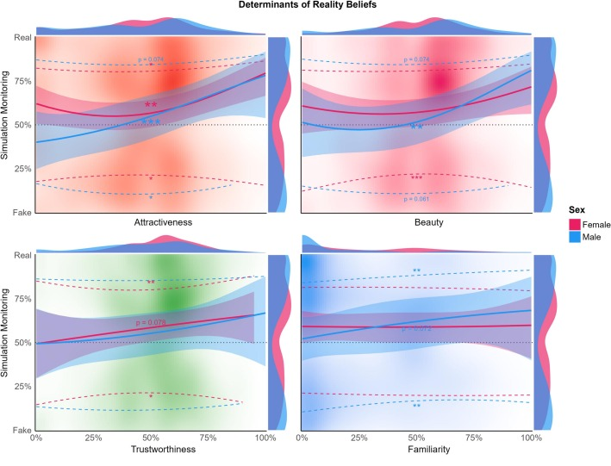
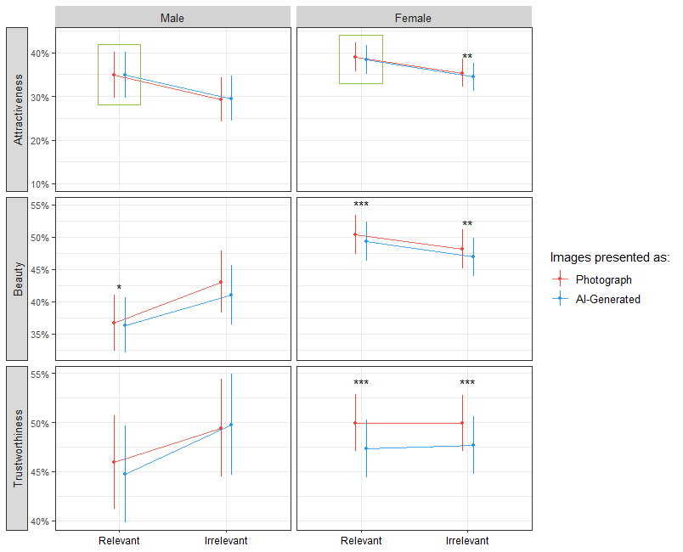
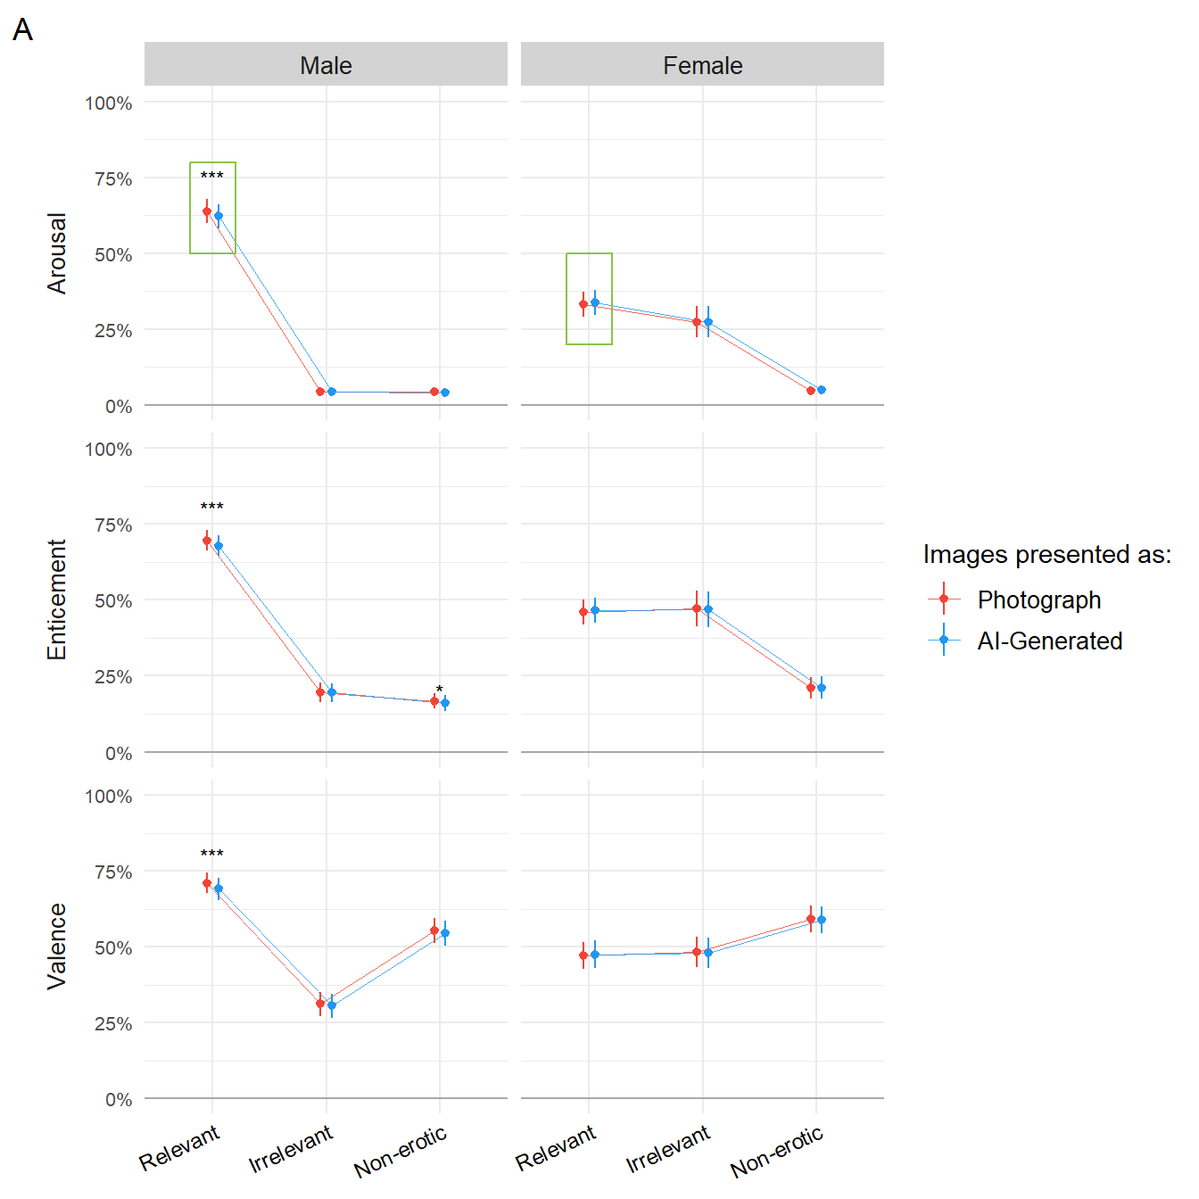
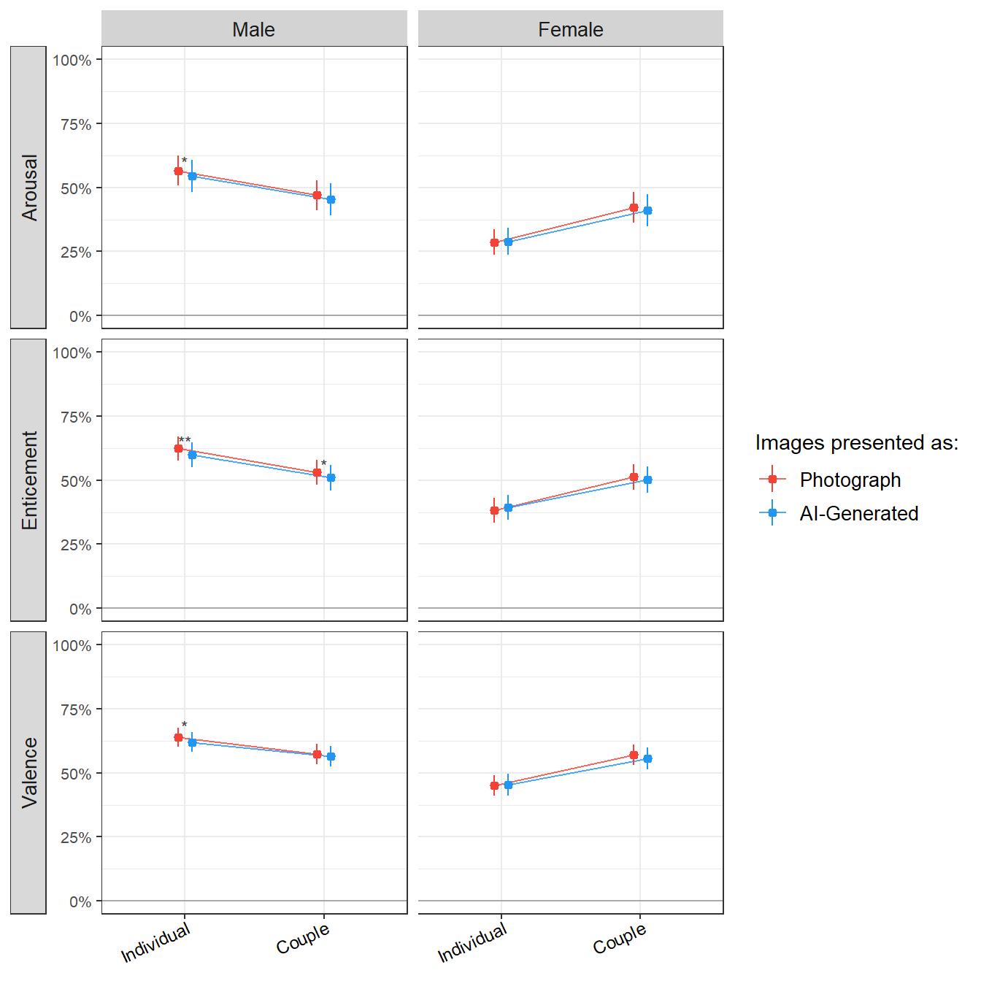


INTRO
STUDY 1*
145 participants (Mean age = 28.3, SD = 9.0, range: [19, 66]; Gender: 48.3 % females, 51.0 % males, 0.7 % others)
STUDY 2
206 participants (Mean age = 27.8, SD = 13.6, range: [18, 69]; Gender: 76.7% women, 23.3% men)
STUDY 3
705 participants (Mean age = 30.2, SD = 11.8, range: [18, 80], 0.1% missing; Gender: 35.7% females, 64.3% males)
STUDY 4
197 participants (Mean age = 36.5, SD = 13.1, range: [18, 80]; Gender: 48.2% women, 51.8% men)
Attractiveness
Trustworthiness
Beauty
Familiarity
Attractiveness
Trustworthiness
Beauty
Arousal
Enticement
Valence
Arousal
Enticement
Valence
Realness
Realness
Realness
Realness
METHODS
Stimuli: NEUTRAL FACES
Stimuli: NON-EROTIC + EROTIC IMAGES
Stimuli: NEUTRAL FACES
Stimuli: EROTIC IMAGES
NEUTRAL
FACES
American Multiracial Face Database (AMFD, J. M. Chen et al., 2021)
NON-EROTIC Nencki Affective Picture System (NAPS, Marchewka et al., 2014)
P H A S E 1
AI-GENERATED
STIMULI #1
SUBJECTIVE ASSESSMENT
PHOTOGRAPH
STIMULI #2
SUBJECTIVE ASSESSMENT
PHOTOGRAPH
STIMULI #3
EROTIC
Erotic subset for the Nencki Affective Picture System (NAPS ERO, Wierzba et al., 2015)
POSITIVE AROUSAL
STIMULI
P H A S E
2
STIMULI
STIMULI #3
REALNESS ASSESSMENT
STIMULI #5
REALNESS ASSESSMENT
STIMULI #1
REALNESS ASSESSMENT
STIMULI #8
REALNESS ASSESSMENT
“AI-Generated” leads to a decrease in emotional responses
Subjective ratings
Realness
Moderators
Subjective ratings
Realness
Moderators
Subjective ratings
Realness
Moderators
Subjective ratings
Realness
Moderators
RESULTS
Fig1. The effect of face ratings on 1) the probability of judging a face as real vs. fake (solid line) and 2) on the confidence associated with that judgement (dashed lines) depending on the sex. Stars indicate significance (p < .001***, p < .01**, p < .05*).
Realness
Realness
Realness
Realness
DISCUSSION
* Makowski, D., Te, A. S., Neves, A., Kirk, S., Liang, N. Z., Mavros, P., & Chen, S. A. (2025). Too beautiful to be fake: Attractive faces are less likely to be judged as artificially generated. Acta Psychologica, 252, 104670.
Notes:
Png transparent background for badgers#
Title , authors,

